Slide 1

Smart
Egyptian League Simulation
by:
• Khaled Wael
• Khaled Mohamed Mousa
• Khaled Gamal Ebrahim
• Khaled Gamal Mamon
• Khaled Elnaqib
• Eslam Samy Eldewany

Slide 2

Introduction
A dynamic web platform that simulates the Egyptian Premier League using automated algorithms to schedule matches, generate results, and update team standings in real time. Users can select their favorite team and play through an interactive mini-game, while the system simulates the remaining fixtures automatically.

Slide 3
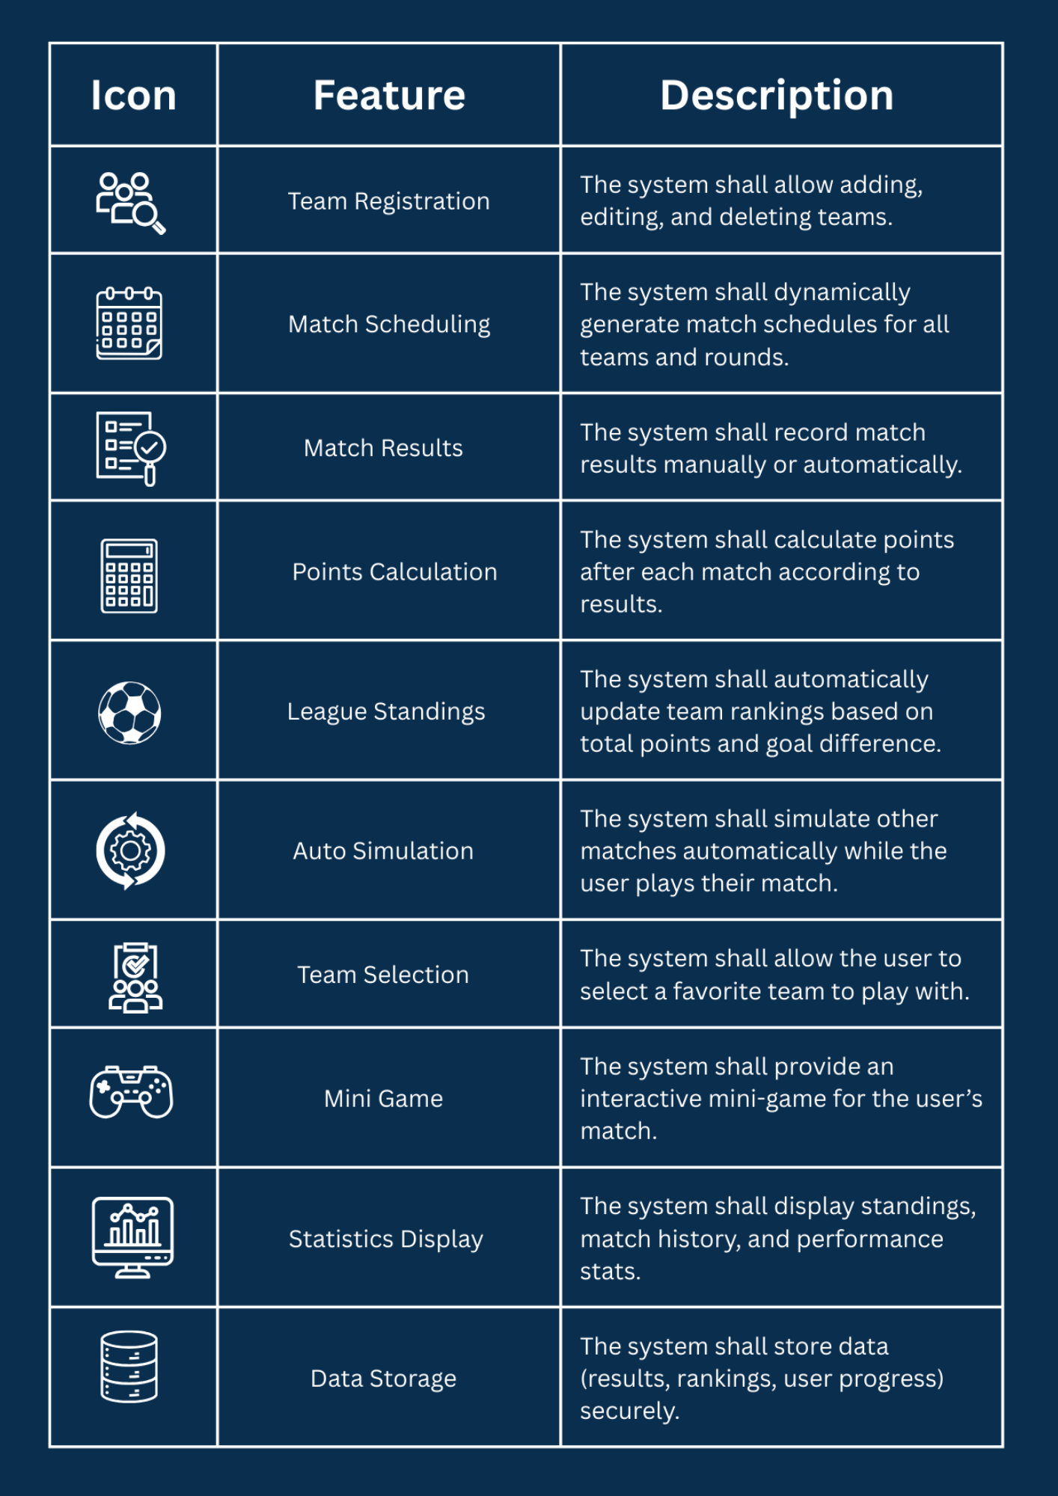
Functional Requirements Overview
Key features enabling the league simulation
This diagram illustrates the core functional requirements of the Egyptian Football League Simulator, including match scheduling logic, result generation, standings calculation, and the interactive mini-game flow. It highlights how each feature contributes to delivering a dynamic and engaging user experience.

Slide 4
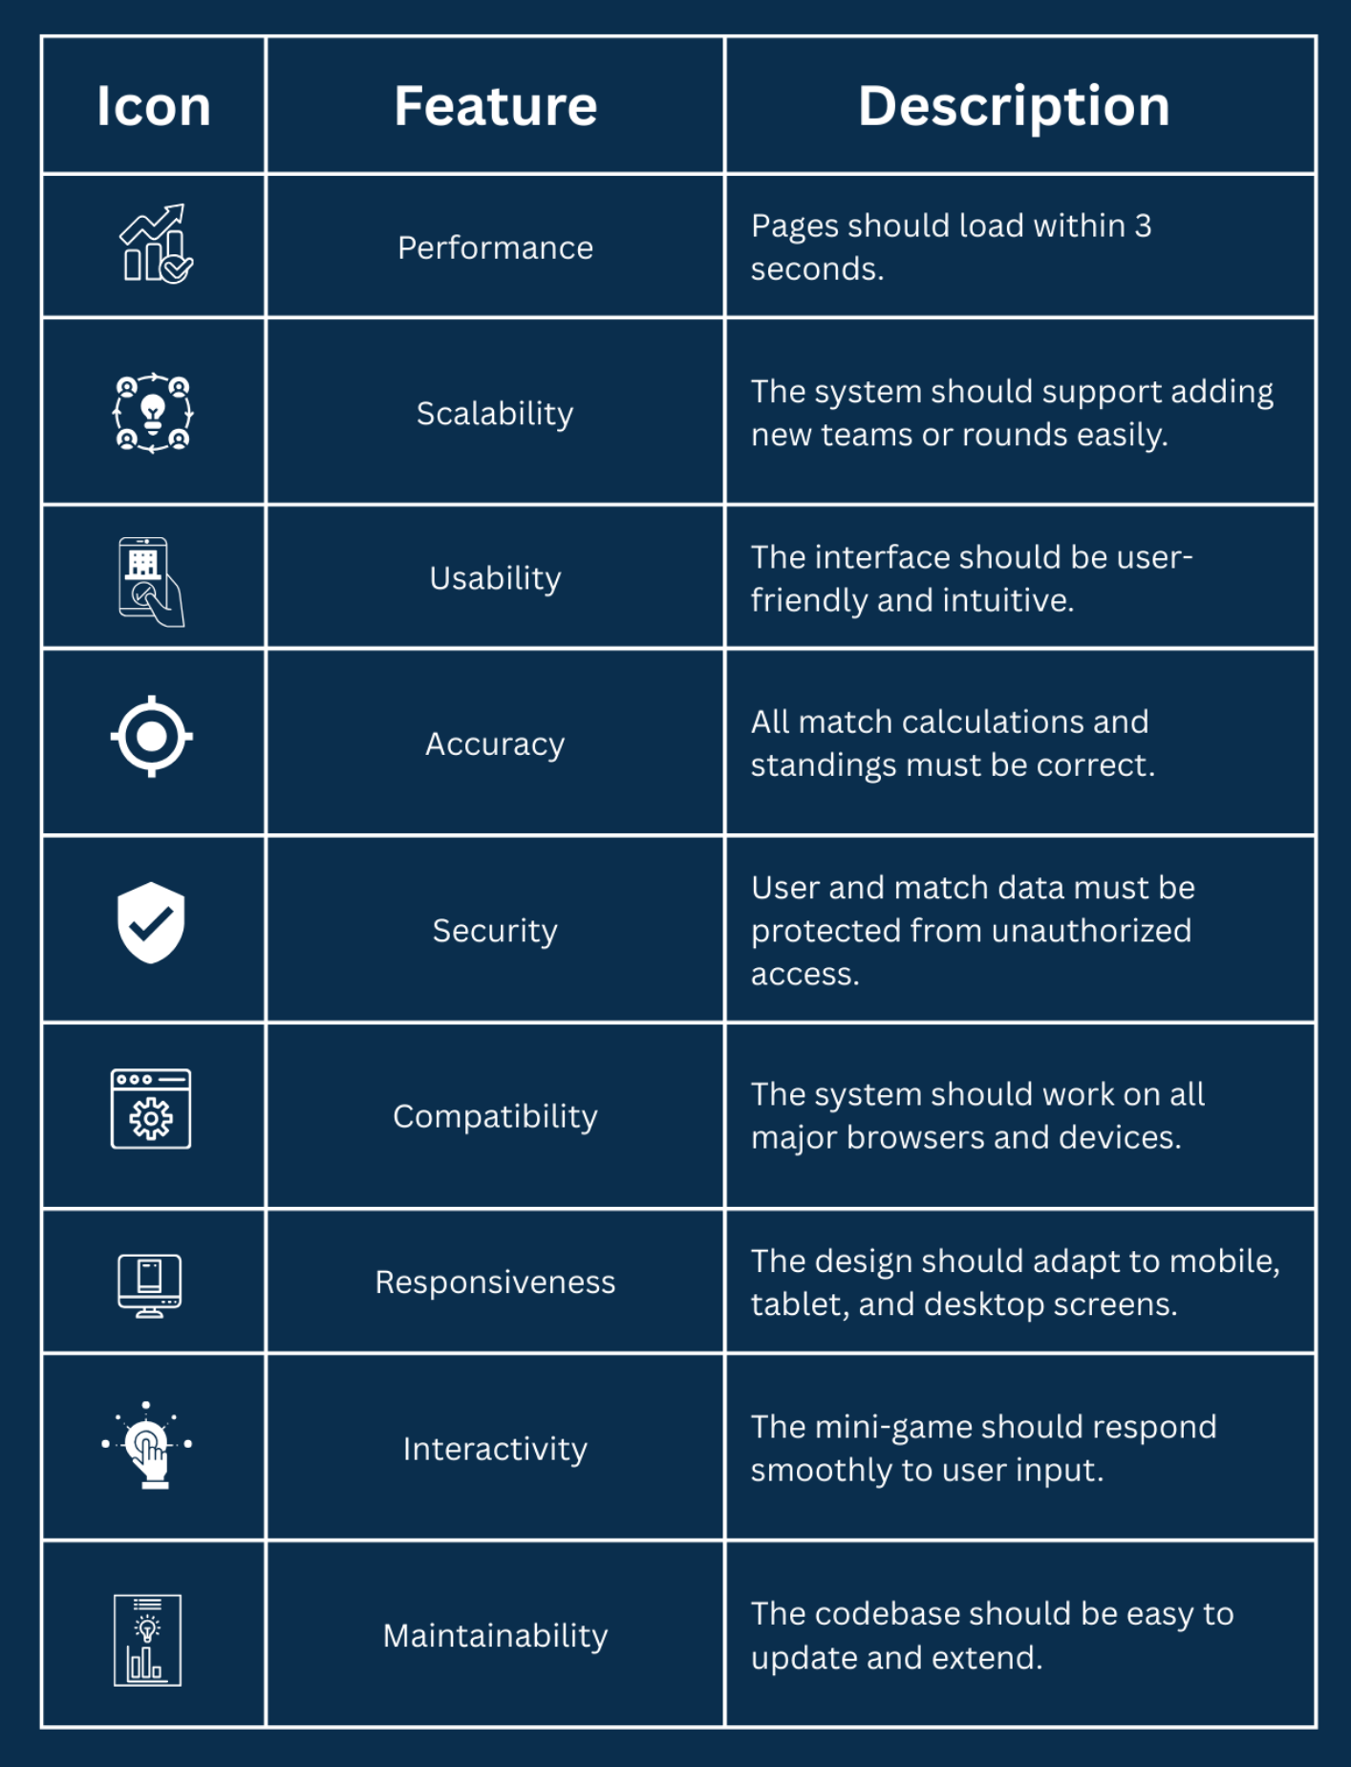
Non-Functional Requirements Overview
Quality attributes ensuring smooth system performance
This diagram outlines the key non-functional requirements of the Egyptian Football League Simulator, covering performance, reliability, usability, scalability, and security standards. These attributes ensure the platform runs efficiently, handles user interactions smoothly, and maintains a consistent, secure experience across all features.

Slide 5
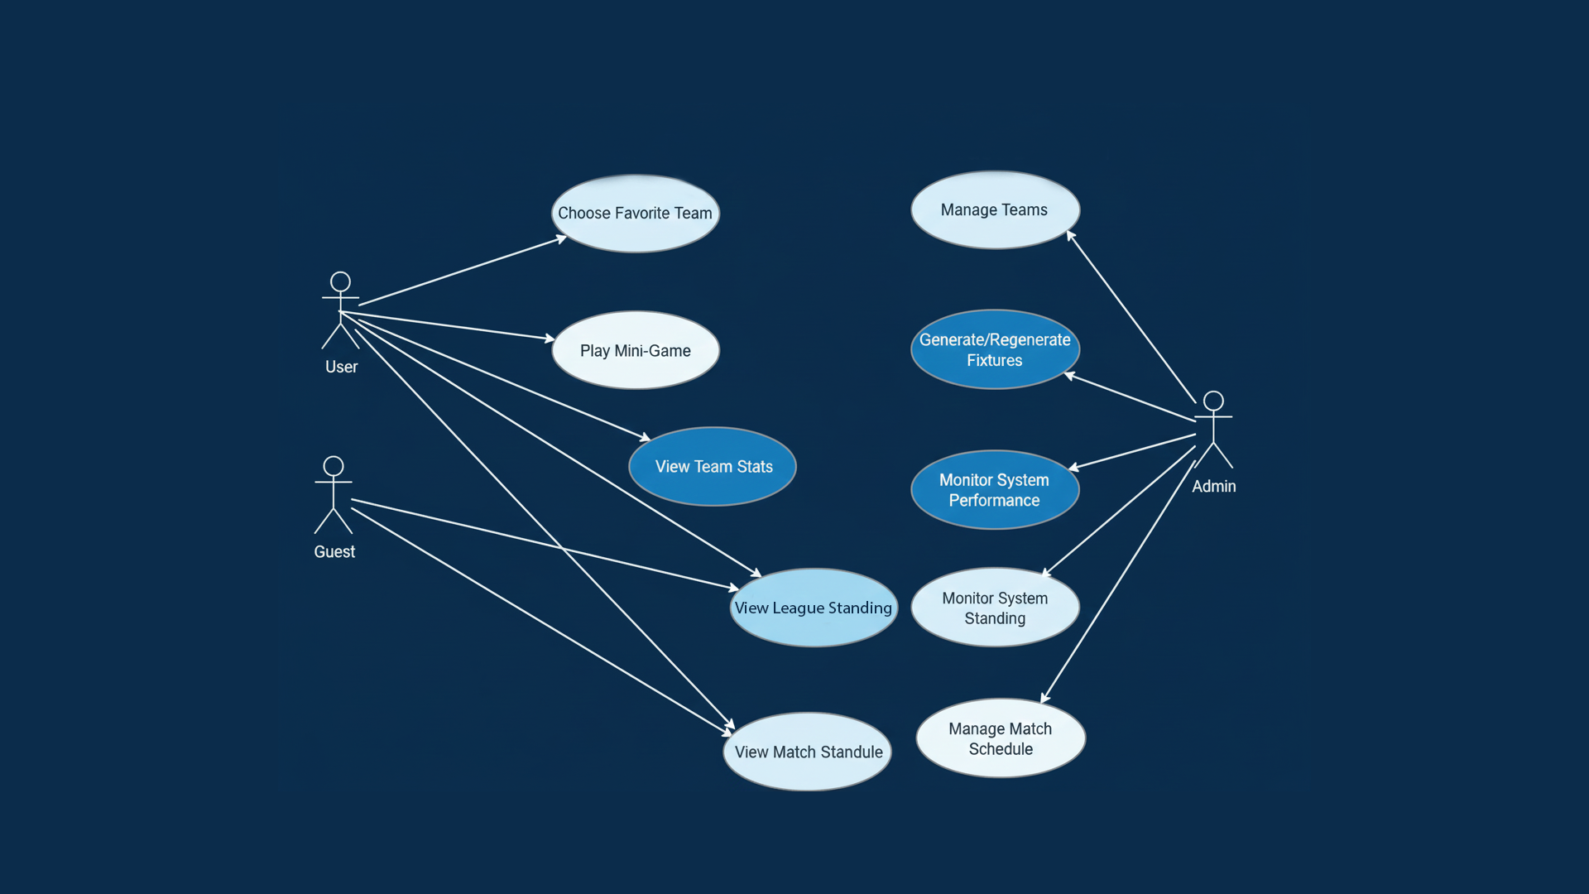
Use Case Overview

Slide 6
Sequences Diagrams Overview
This diagrams show the step-by-step flow of interactions between system components.
It highlights the order of messages exchanged and clarifies how the process progresses over time.

Slide 7
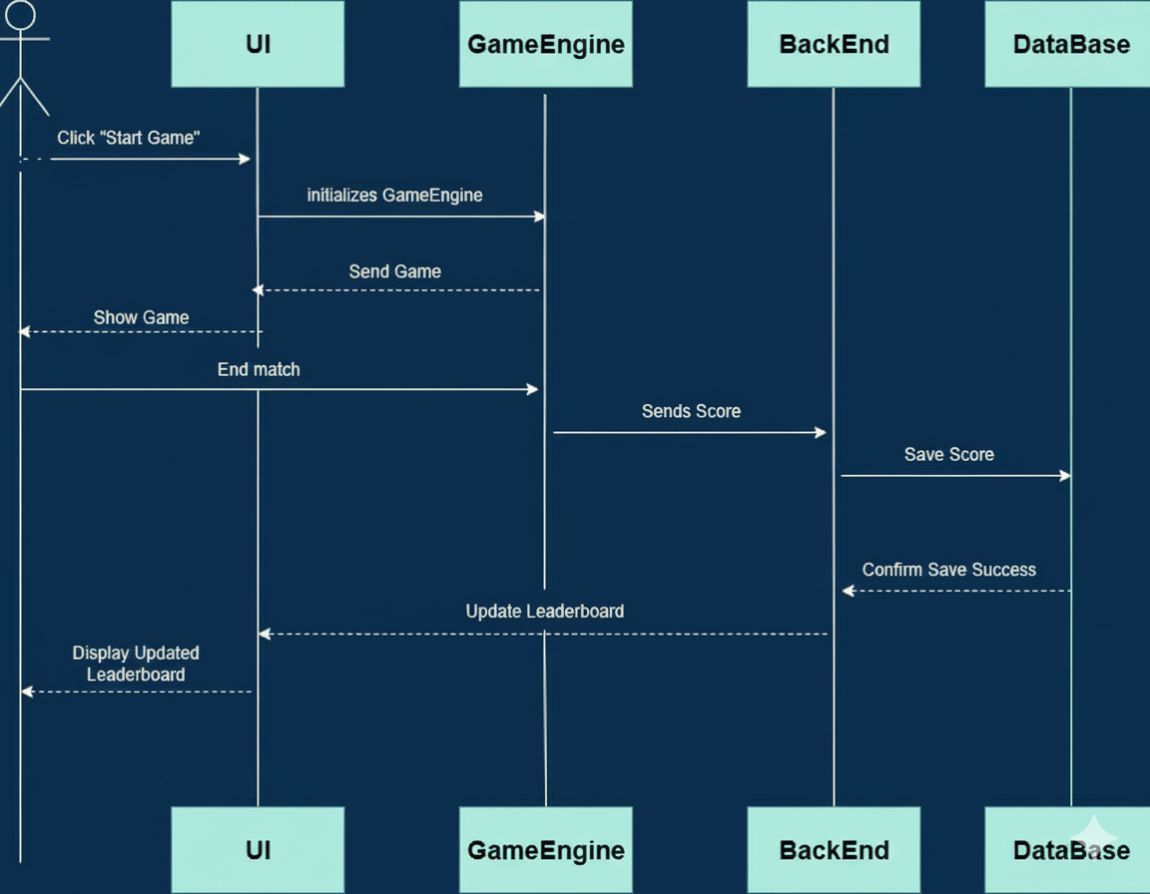
Game Sequence

Slide 8
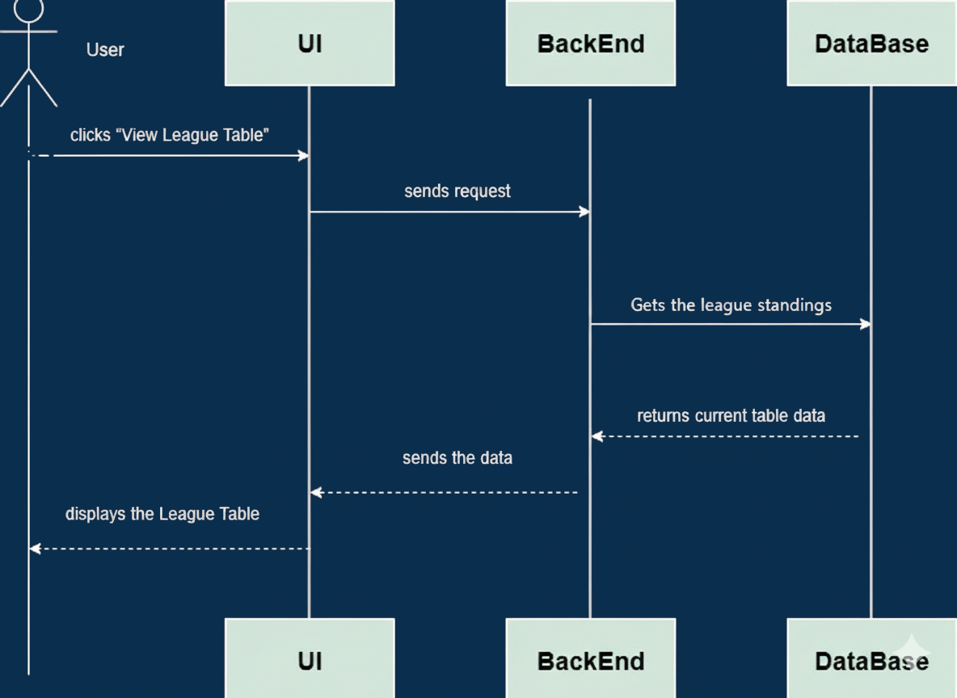
League Table Sequence

Slide 9
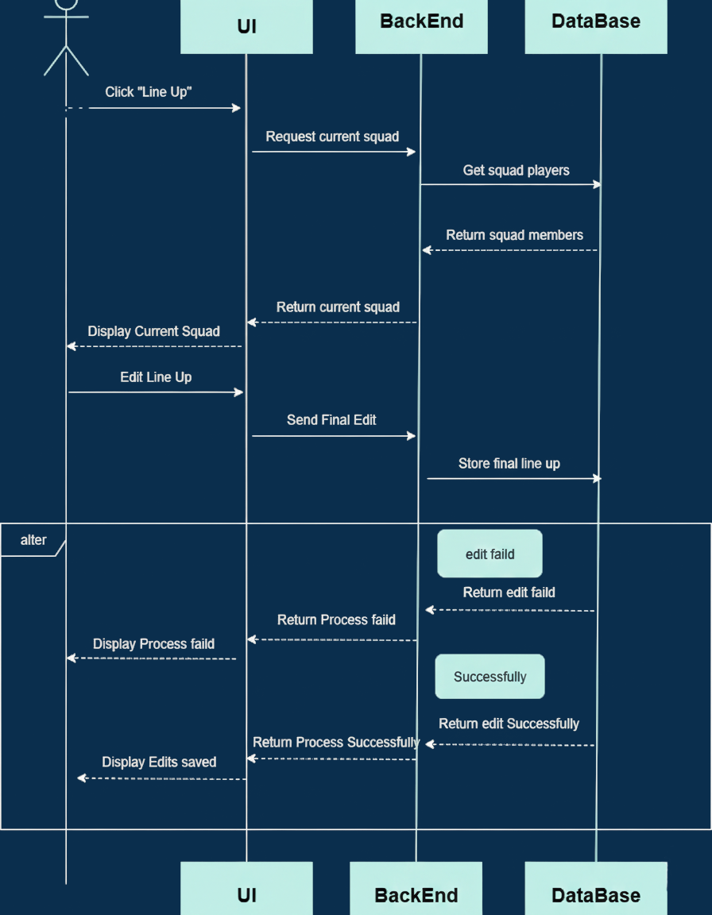
Line-up Sequence

Slide 10
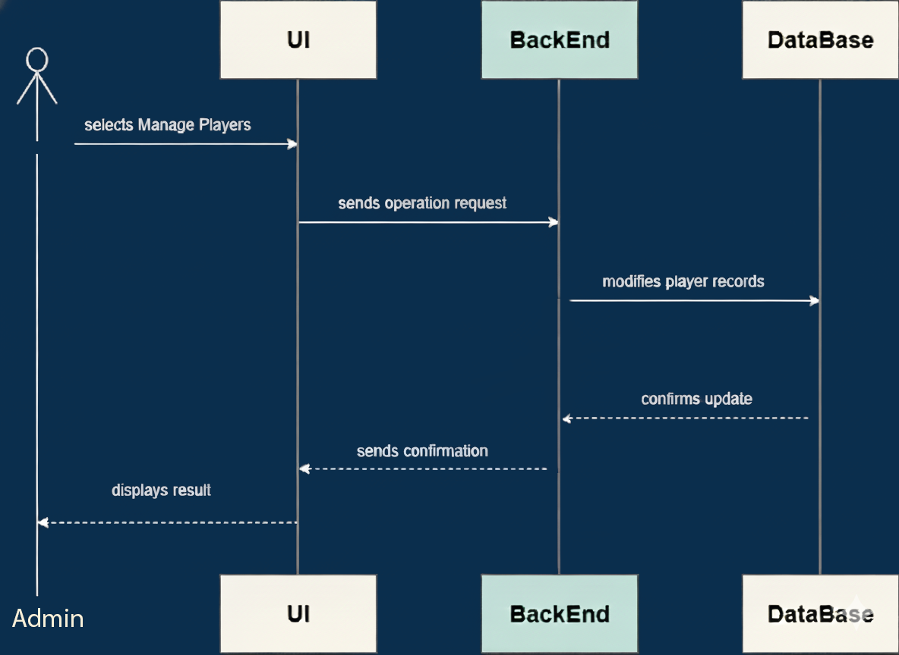
Manage Players Sequence

Slide 11
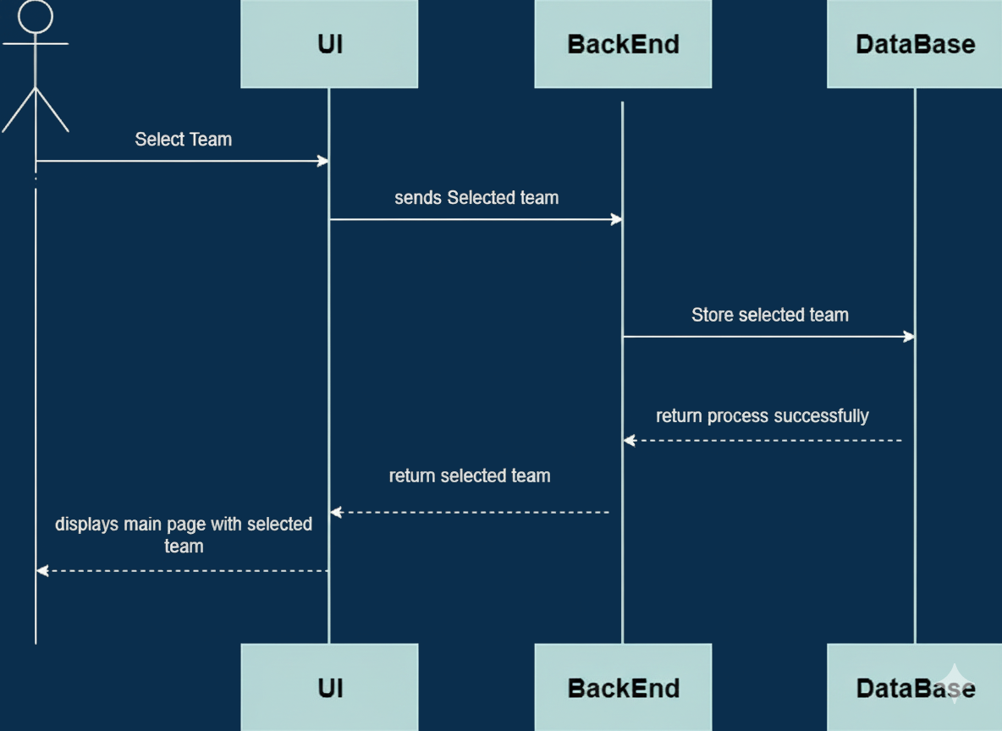
Select Team Sequence

Slide 12
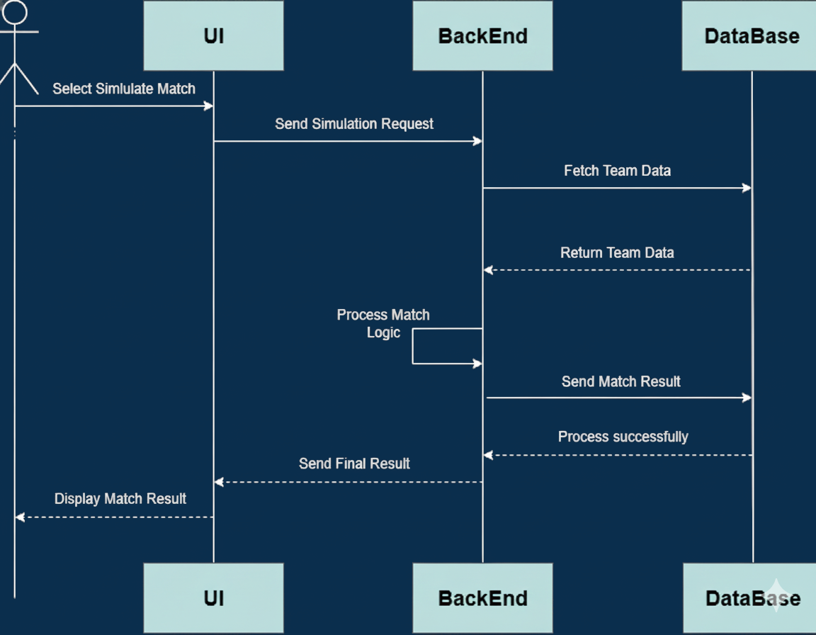
Simulate Match Sequence

Slide 13
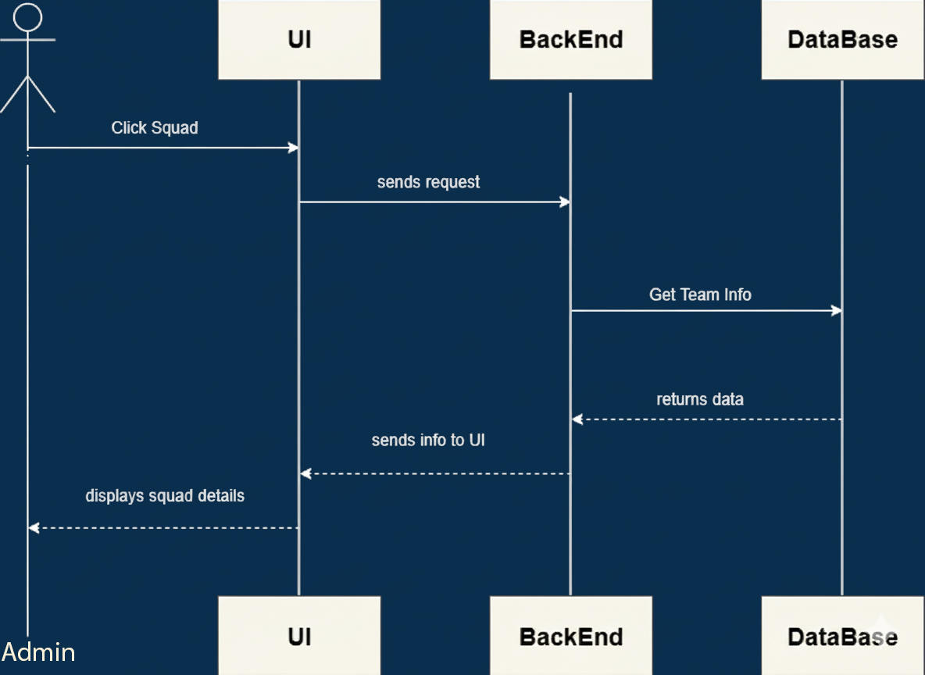
Team Details Sequence

Slide 14
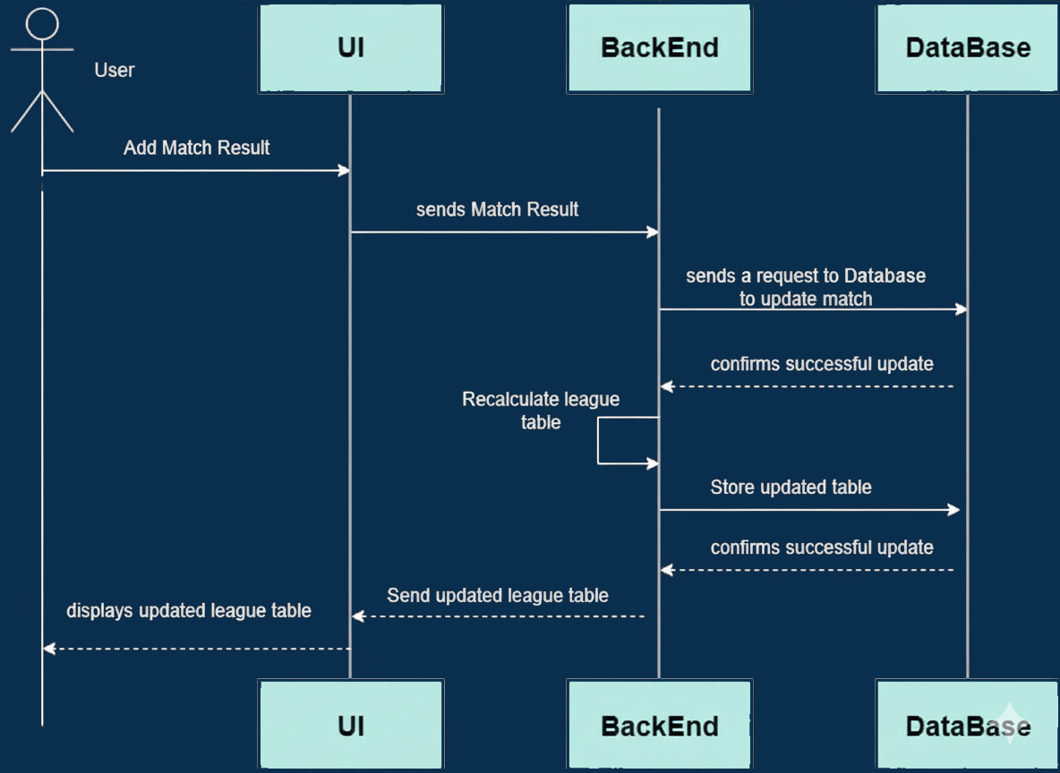
Update league table Sequence

Slide 15
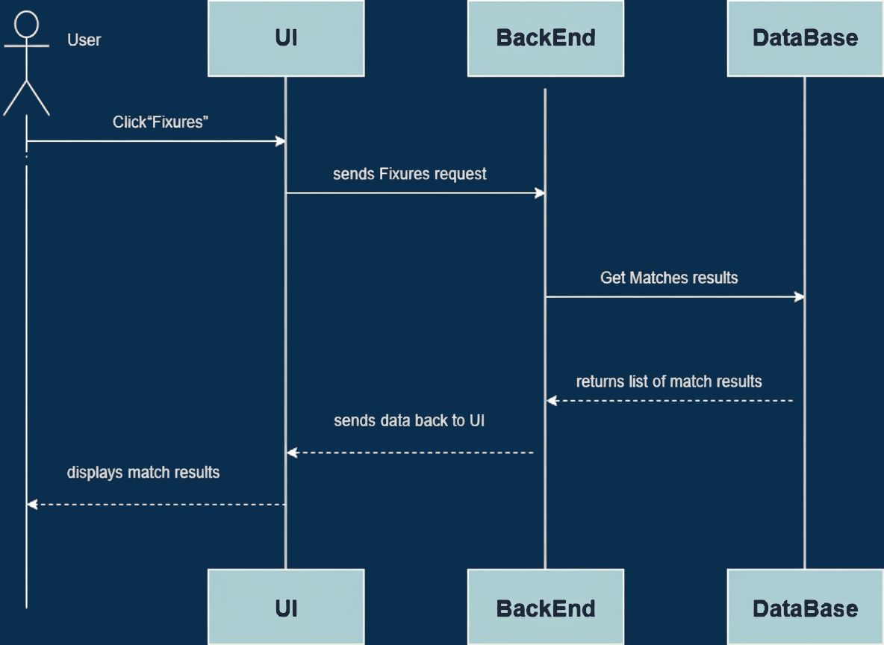
View Match Results Sequence

Slide 16
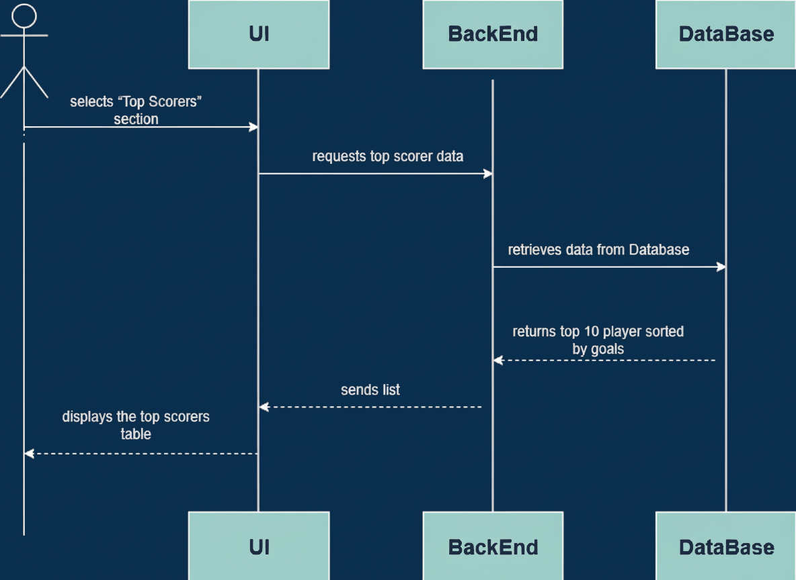
View
Top
Scorers
Sequence

Slide 17
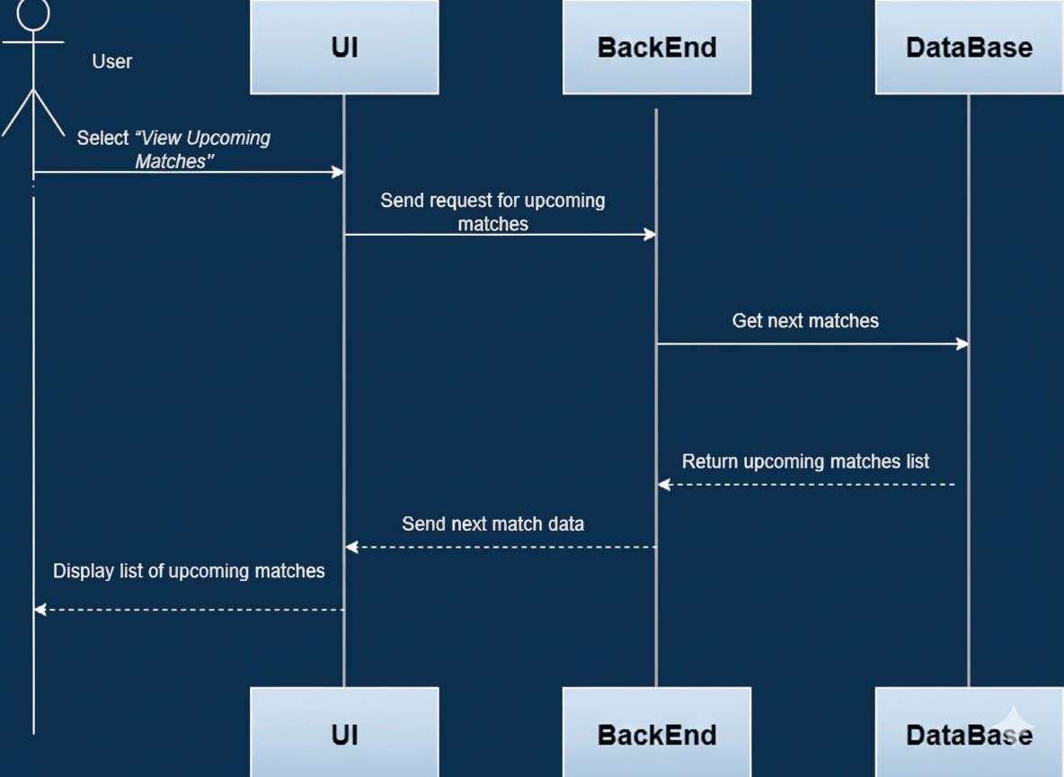
View Upcoming Matches
Sequence

Slide 18
Activities Diagrams Overview
This diagrams illustrates the main workflow of the process.
It shows the sequence of actions, decisions, and parallel activities that shape how the system operates.

Slide 19
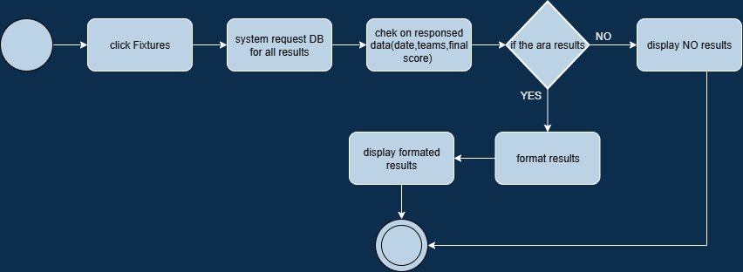
All Matches Results Activity

Slide 20
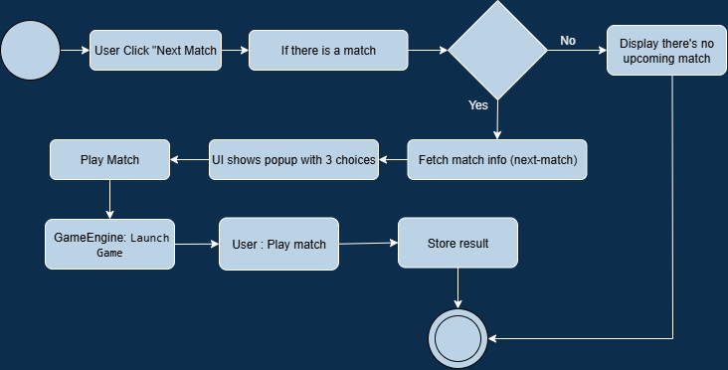
Game Activity

Slide 21
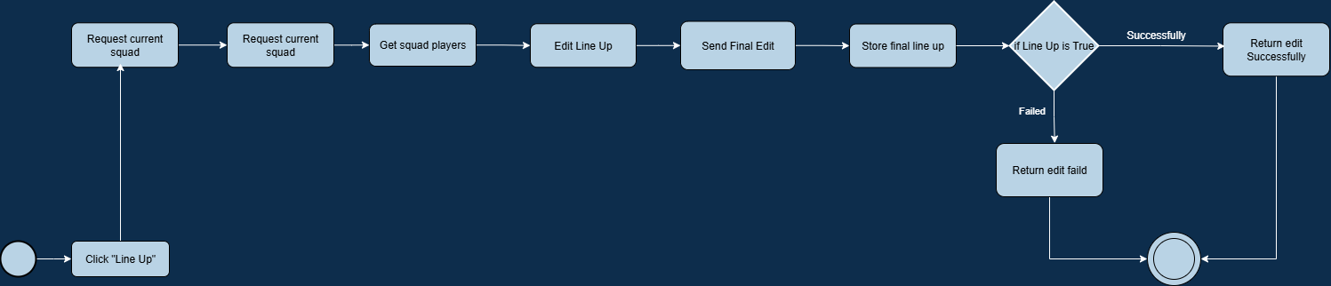
Line-up Activity

Slide 22
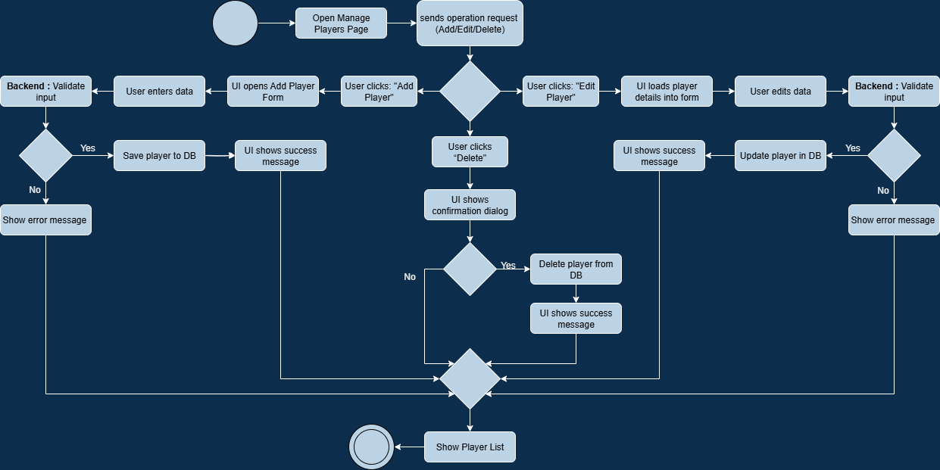
Manage Players Activity

Slide 23

Simulation Activity

Slide 24
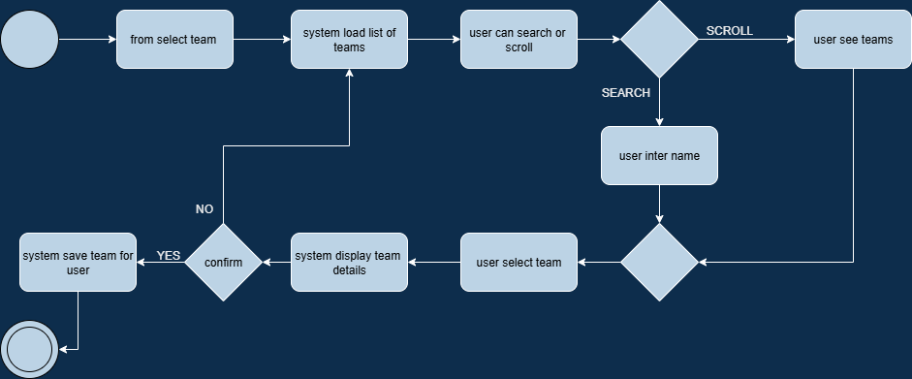
Select team Activity

Slide 25
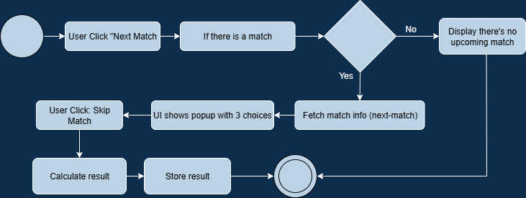
Skip Match Activity

Slide 26
League Table Activities

Slide 27
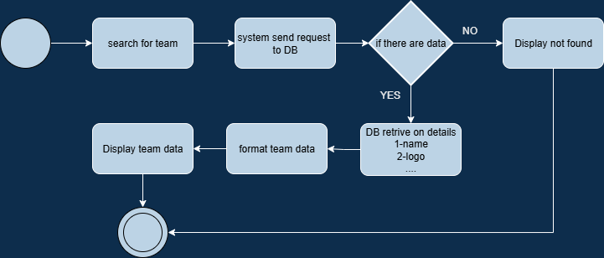
View team details Activity

Slide 28
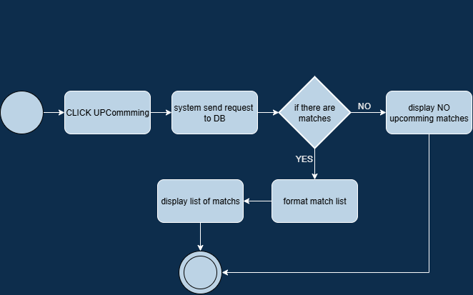
view upcoming Activity

Slide 29
View Top Scorers Activity

Slide 30
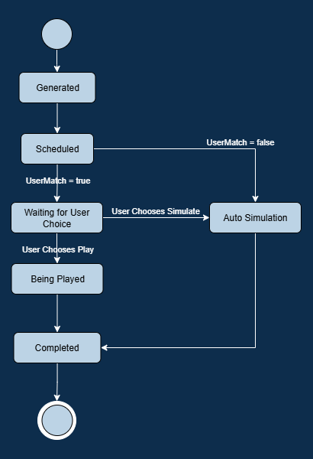
System States Overview
Understanding the simulator's operational states
This diagram illustrates the various states the simulator can adopt during operation, including initialization, match scheduling, and user engagement, providing insights into the dynamic nature of the system.

Slide 31
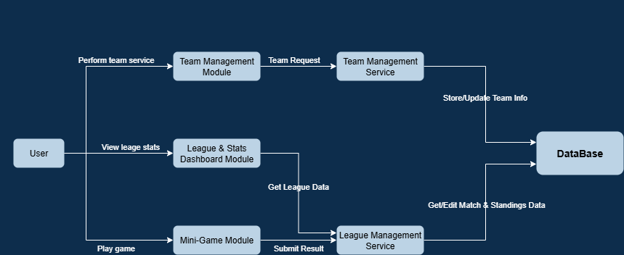
System Architecture Overview

Slide 32
Class Diagram Overview
This diagram outlines the core classes that form the simulator’s structure, highlighting their attributes, operations, and relationships. It provides a clear view of how system components interact and collaborate to deliver the platform’s functionality.

Slide 33
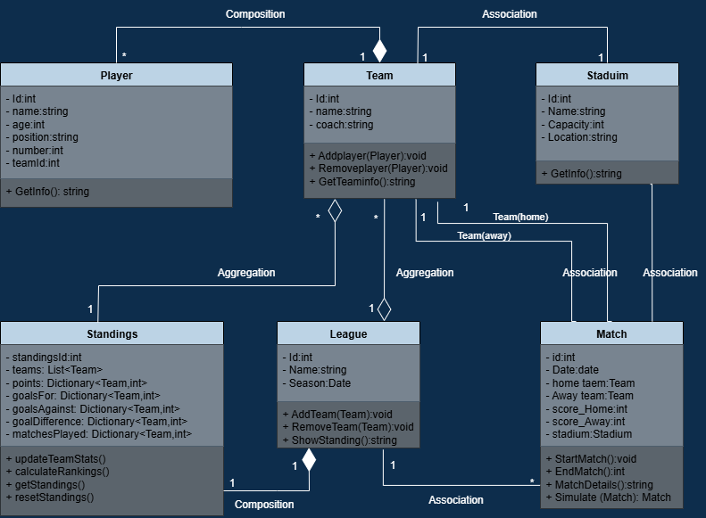
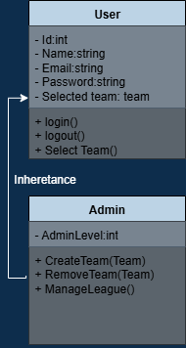

Slide 34
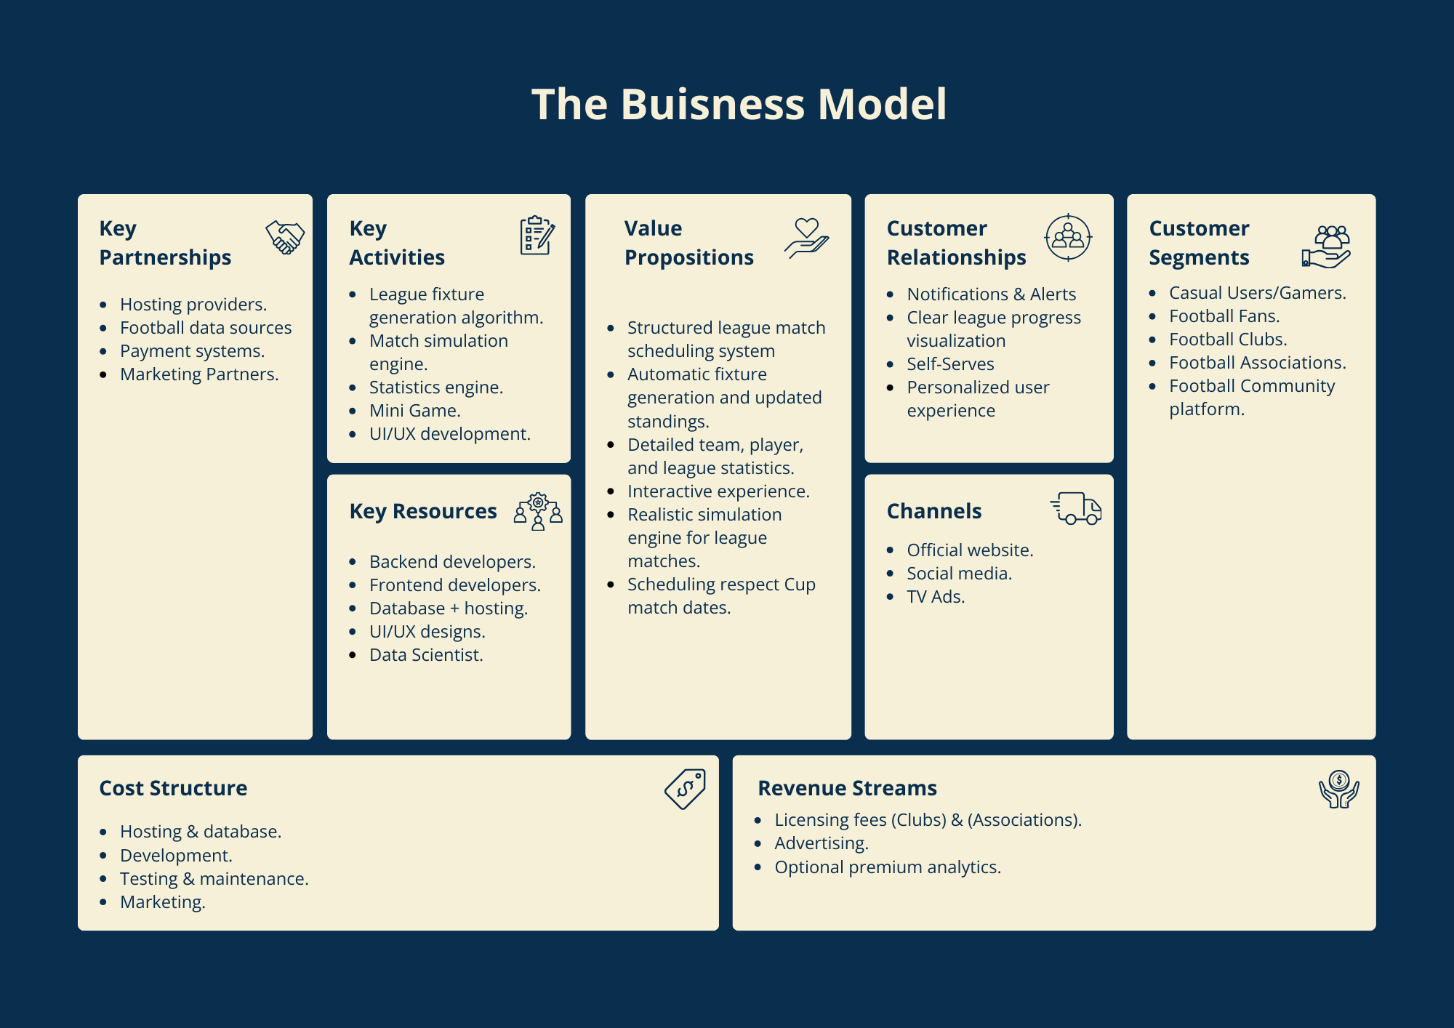
Business Model

Slide 35

Thank you
for being part of our journey

